Slide 1
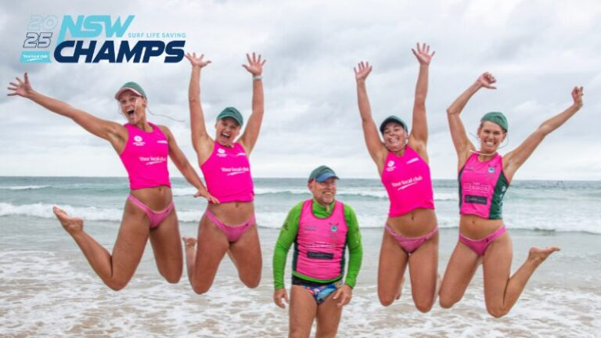
STATE AGE CHAMPIONSHIPS 2025
Age Manager’s Information Briefing

Slide 2

AGENDA
Introductions
Program
Logistics
Asks
Q&A

Slide 3
INTRODUCTIONS – Carnival Crew
Surf Sports Director – Fernando Lonergan
Team Managers – Grant Bowmer & Keli McGuinness
Head Coaches – Ian Ross (Water) & Jock Campbell (Beach)
Assistant Coaches;
Water – Luke Turner, Tate Brannock, Cam Pyett, Matt Brown, Scott Sutton, Mick Prince, Nathan Smith, Nathan Spinner, Rhys Christensen
Beach – Larry Leabeater, Milla Cole, Sienna Alderson (Heather), Cori Campbell
Volunteers – Age Managers, Water Safety , Officials, IRB, Tent Titans

Slide 4
PROGRAM

Slide 5
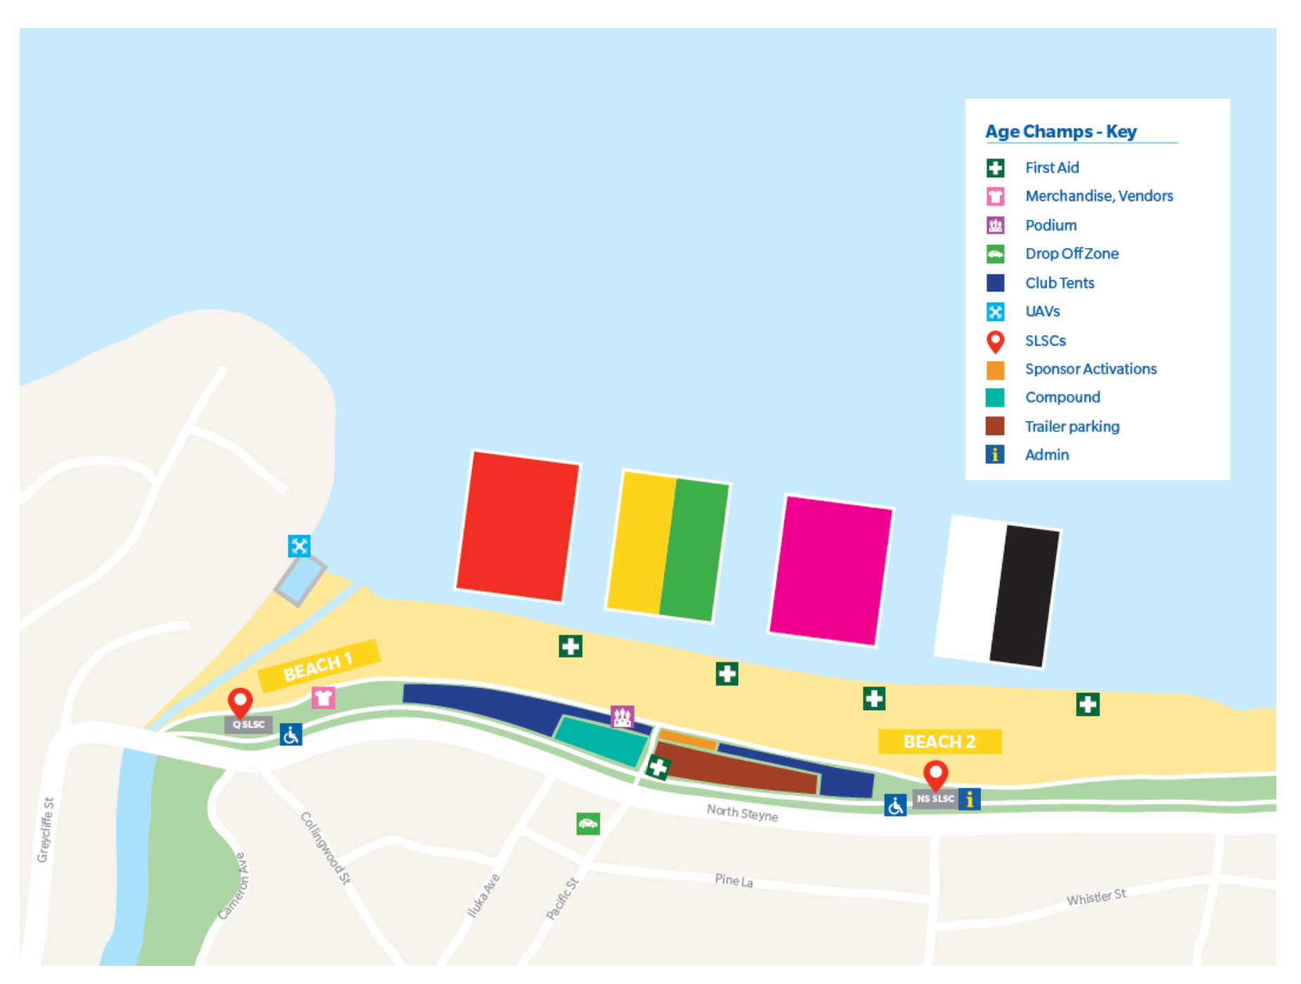
EVENT MAP

Slide 6
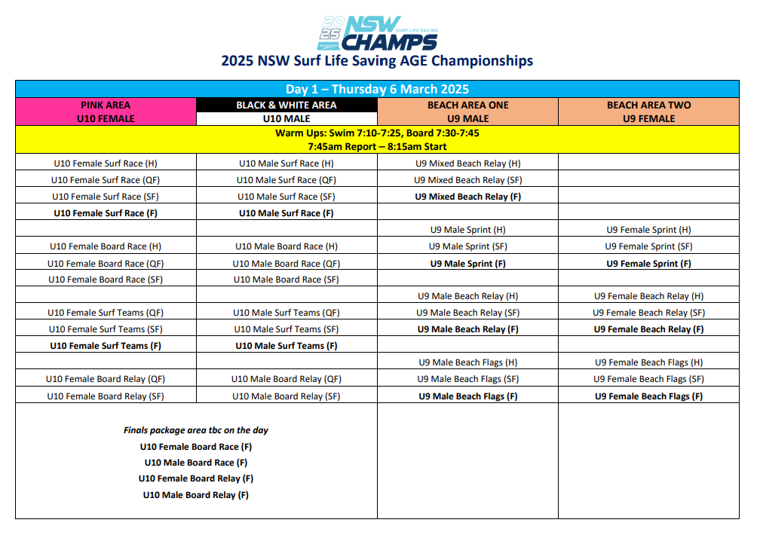

Slide 7
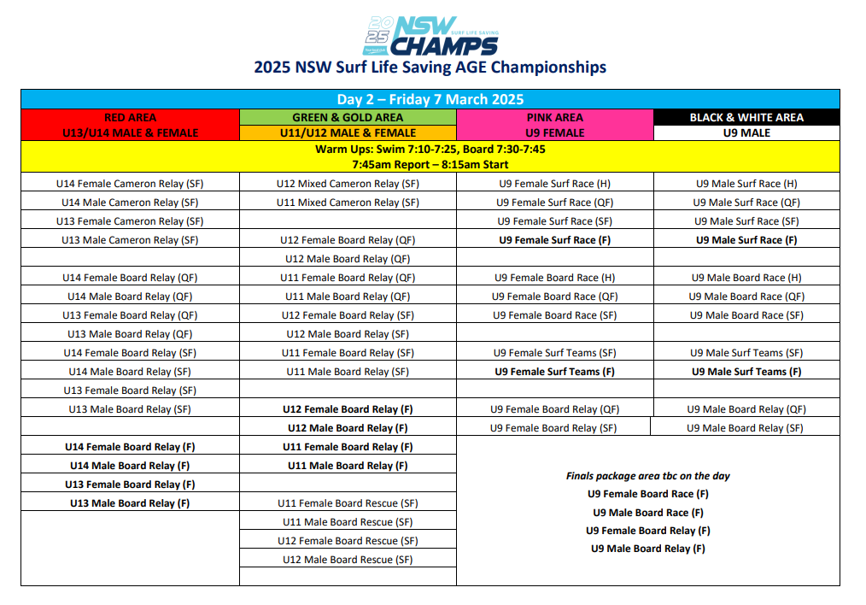

Slide 8
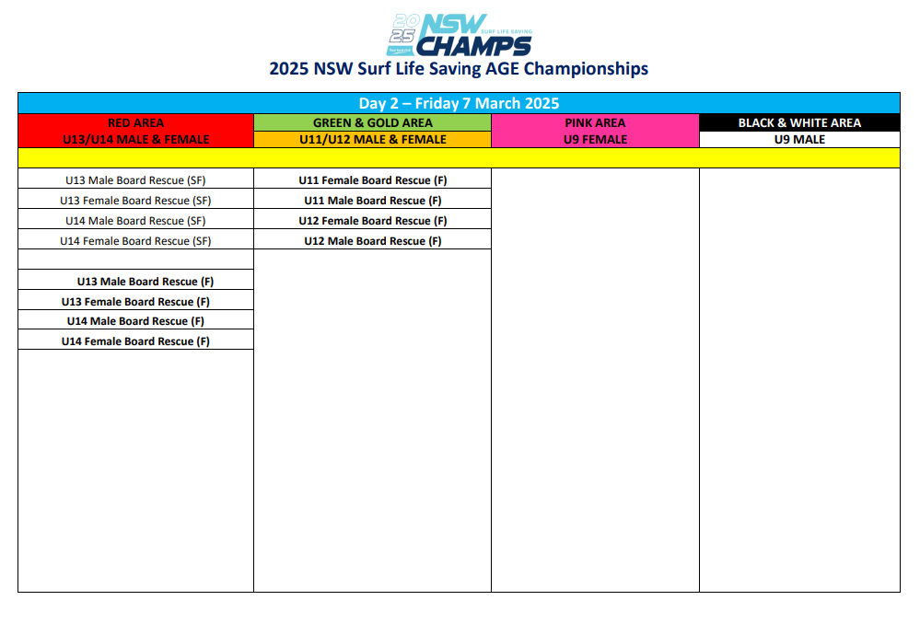

Slide 9
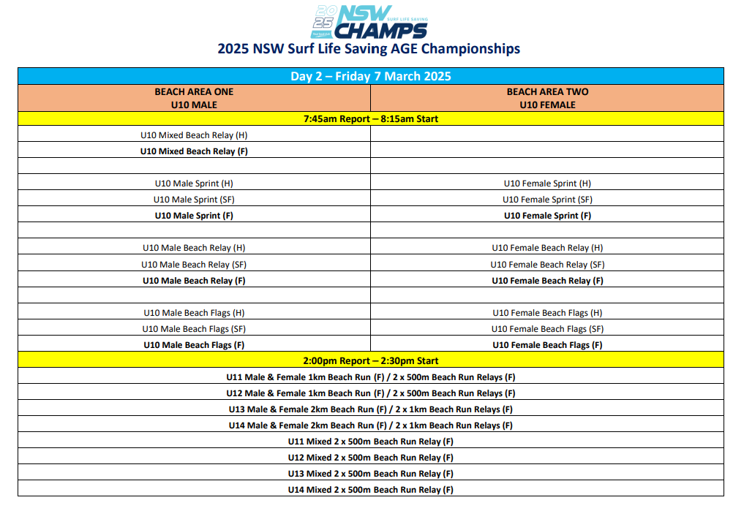

Slide 10
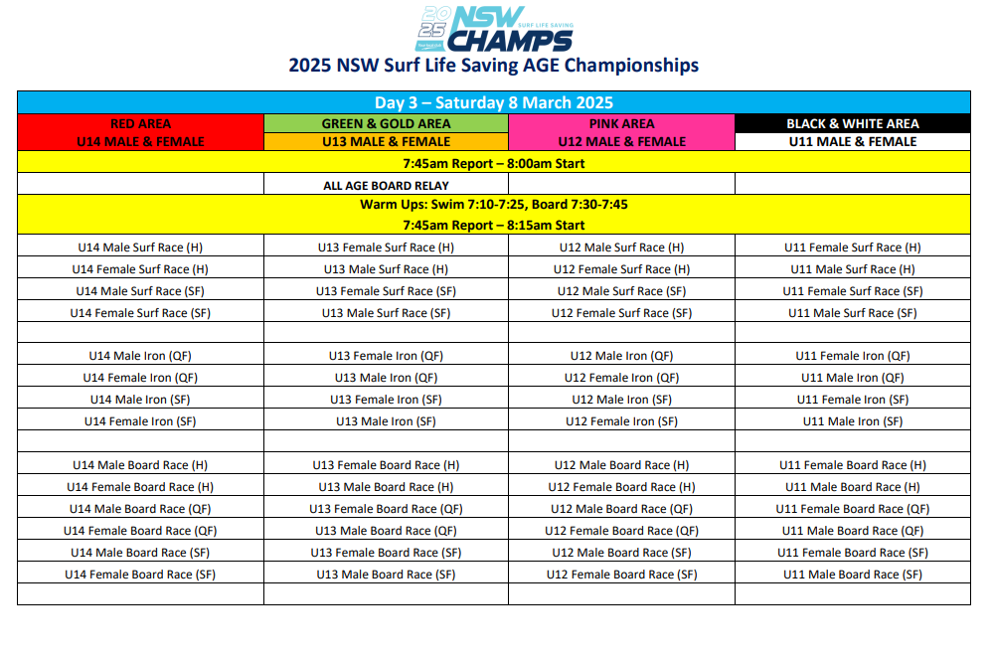

Slide 11
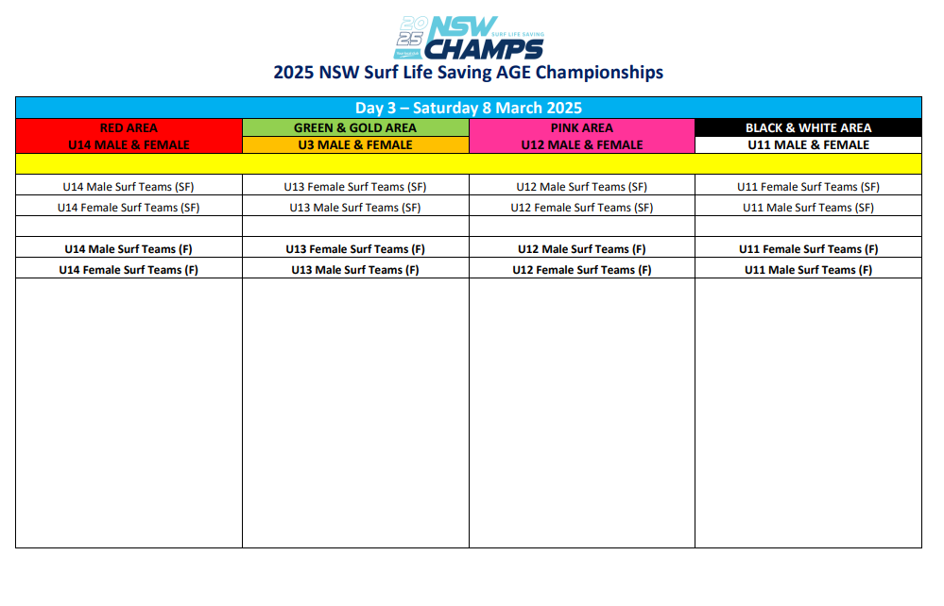

Slide 12
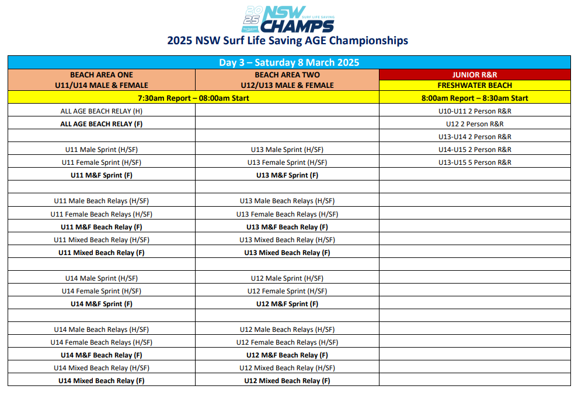

Slide 13
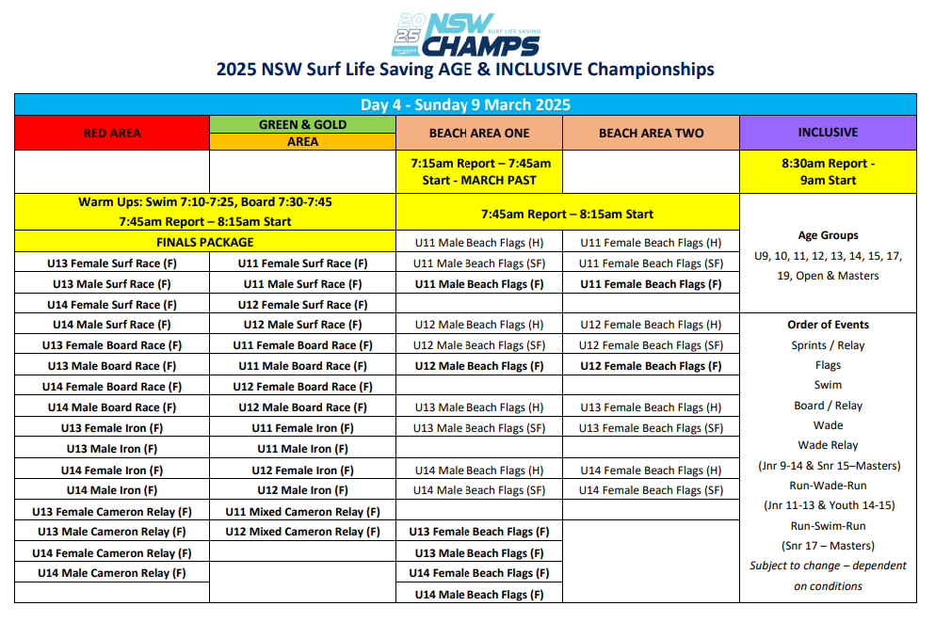

Slide 14
LOGISTICS
7:15am Wanda Age Managers Meeting for 8:15am carnival start time
Age Managers pick up radios 7:30am from Team Manager (Wanda Trailer)
Warm Ups (Water)
7:10-7:25am (Swim)
7:30-7:45am (Board)
Warm Up (Beach) – Start times vary therefore 30mins prior as standard
Parent Code of Conduct
Protests – Immediately contact Team Managers
Team Changes – LiveHeats. Please radio in for Team Managers to amend.
Lost Property / Rubbish
WhatsApp group: ‘Wanda State Team 2025’

Slide 15
ASKS
Positive role model (nippers and parents)
Age Managers not Baby Sitters
Coordination of team events & individual events
Adapt to change
Manage role of Parent v Age Manager
Regular communication / Ask questions
Delegate duties amongst parent group
Respect Competition Area (includes Officials)

Slide 16

Q&A

